Slide 1

"Simplifying Work-Life Balance with Smart Insights."
Ease-Ai

Slide 2

Content
INTRODUCTION
Problem statement
solution
workings
Benefits to users
Future scopes

Slide 3
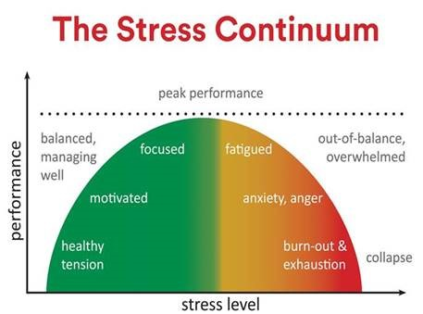
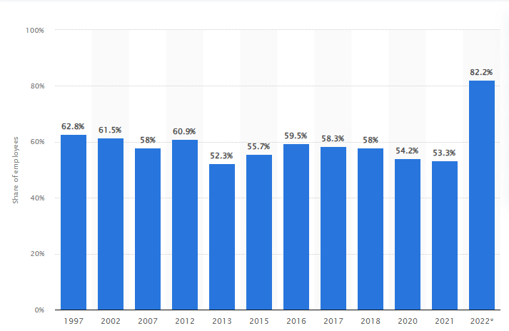
Percentage of employees feeling severely insecure and stressed in their working environment in Japan from 1997 to 2022
The Challenge

Slide 4
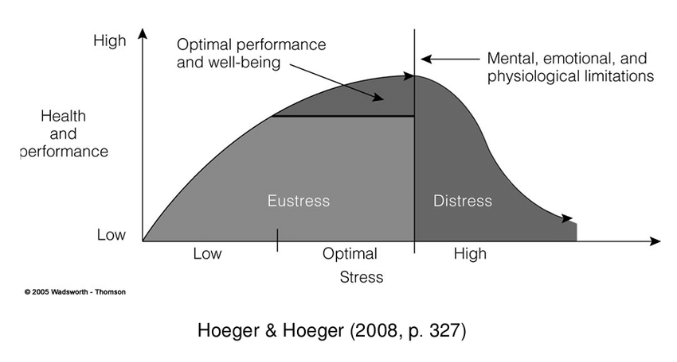
The Challenge
Relation between Mental Health & Stress

Slide 5
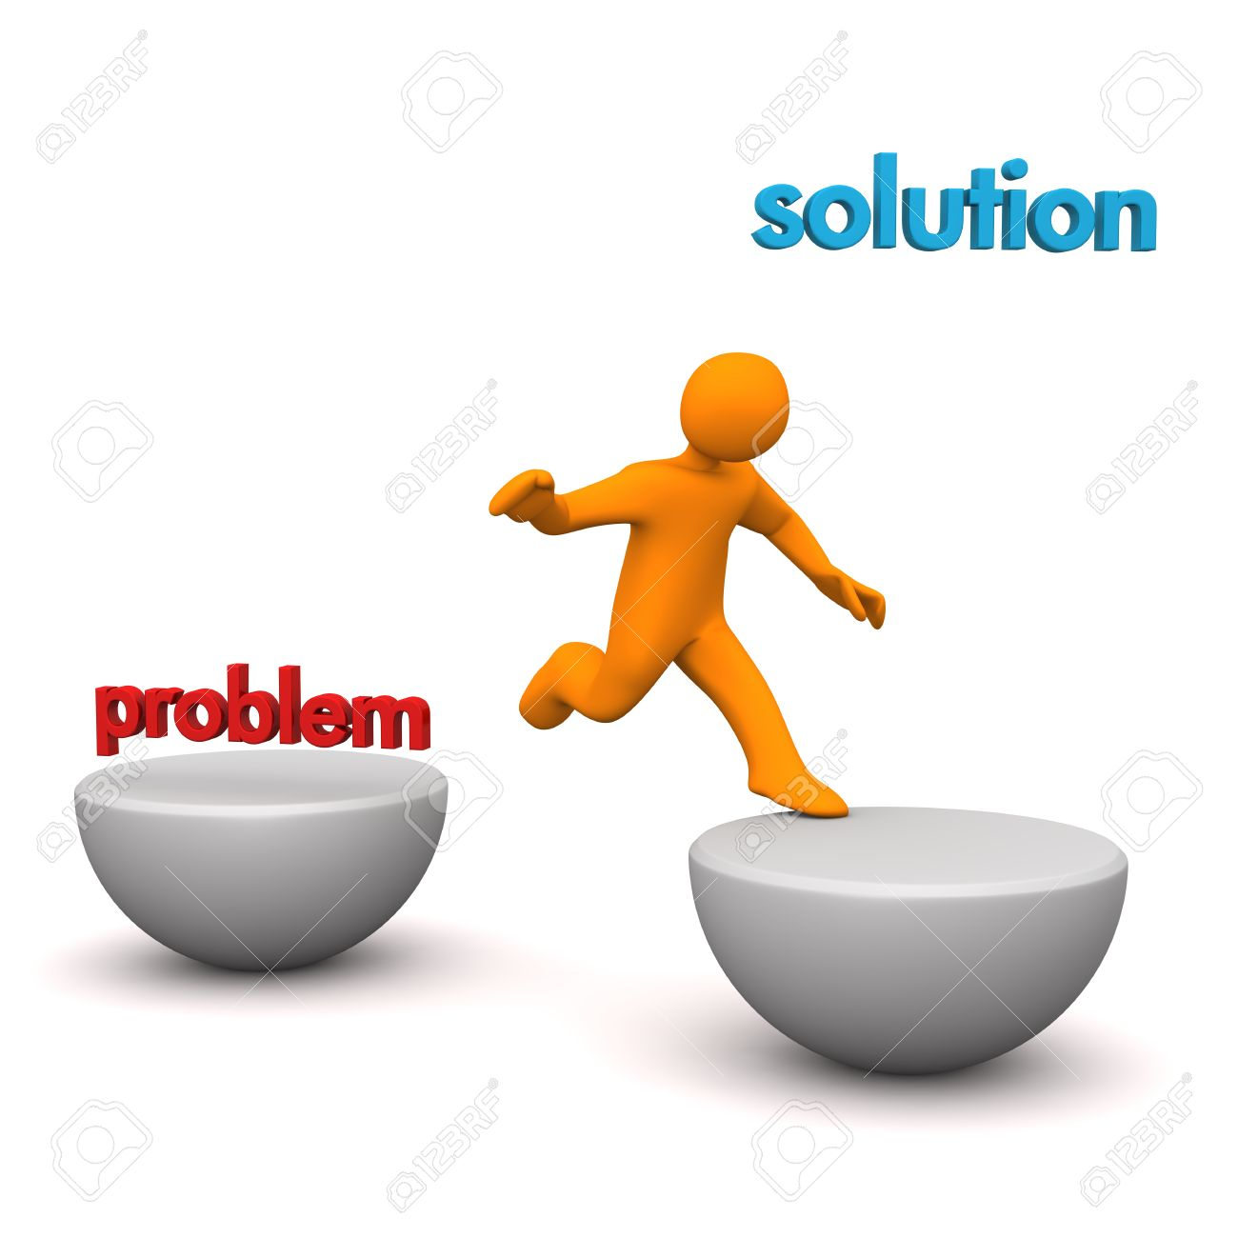
The solution
Daily reviews
Workload analysis
Recommendation
Google Calendar integration

Slide 6
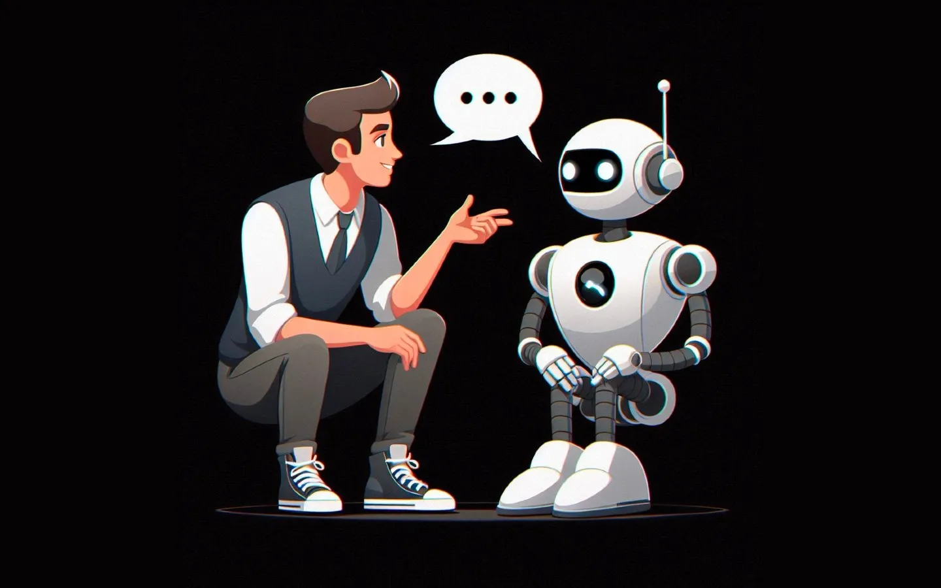
How EaseAI Helps You
Boosts Productivity
Promotes Work-Life Balance
Helps Manage Schedules Effectively
Reduces Stress and Burnout

Slide 7

What’s Next for EaseAI?
Scaling potential
Smarter Features
Reach More People

Slide 8

THANK YOU

